Slide 1
Idaho State Elks Youth, Inc.
David Tatlock, Chair

Slide 2
Idaho State Elks Youth, Inc. is a 501 (c) (3) Non-profit organization formed in 1994.
The Corporation is organized to further the charitable and educational activities of the Benevolent and Protective Order of Elks of the United States of America, and Elks National Foundation. The corporation will receive funds from the Elks National Foundation for the purpose of benefiting charitable projects of the Idaho State Elks Association.
The Directors are the Six Trustees of the Idaho State Elks Association.

Slide 3
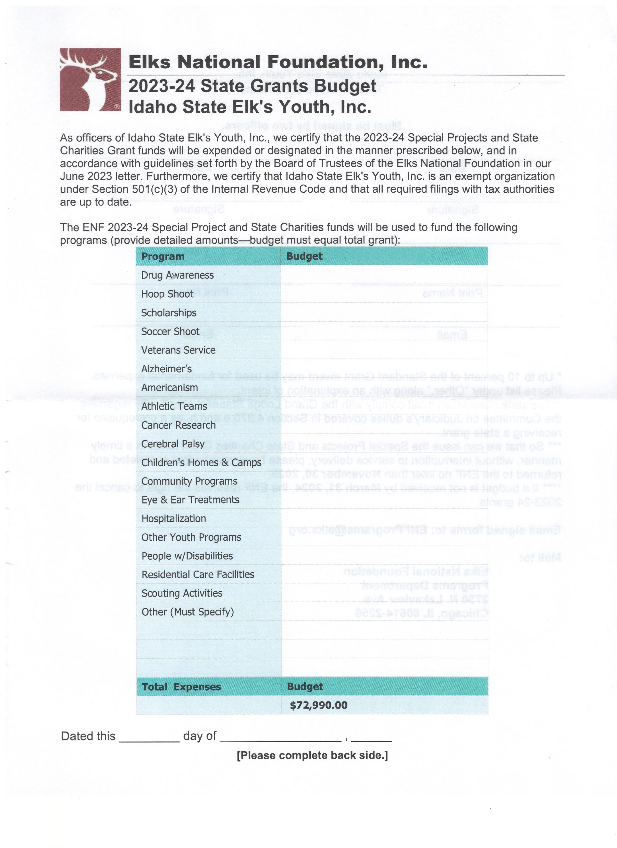

Slide 4
Funds are received from Elks National Foundation based on what has been contributed by Lodges/Members in the prior Fiscal Year. We receive a State Charities Grant, Special Projects Grant and Bonus Grant.
Currently the funds have been allocated to the following programs:
Americanism Essay Contest Winners (District and State)
Drug Awareness Program
Hoop Shoot (State)
Most Valuable Student Scholarships
Veterans Programs
State Project

Slide 5
In the early years Youth, Inc received donations from outside sources along with the donations from ENF. Several years we did not spend all of the funds allocated for the year, creating a “surplus.” These funds need to be spent keeping in mind that they need to be used for charitable purposes.
In 2018 I was told by our State Sponsor at the time, Hon. James Damon, to “spend the money!”
Working with the State Trustees, it was decided that we give the Local lodges grants to be used to assist them with their charitable projects, as long as the project follows a program in the Charity Records Workbook.

Slide 6
These consist of:
Youth Scholarships
Student of Month/Year
Youth Activities
Hoop Shoot
Soccer Shoot
Special Needs Programs
Veterans’ Service Events
Community Service Donations
Health Fairs/Blood Banks
Senior Citizen Programs
Food Baskets
Public Service/Citizen Recognition
Elks National Foundation Donations
Drug Awareness Programs

Slide 7
This year the grant is $2,000 per lodge, has your lodge applied yet?
It is very simple, write or email me your request explaining what project(s) you will be funding with your grant.
dtatlock86@gmail.com
That’s all it takes!
Questions?

