Slide 1


Slide 2
WELCOME
TO
___ LODGE
#____

Slide 3
THE BEGINNINGS
Founded in 1867 as the Jolly Corks with 15 members who were entertainers
In February 1868 the name was changed to the Benevolent and Protective Order of Elks
Celebrated 150 years in February 2018
Fraternal order to promote 4 Cardinal principles: Charity, Justice, Brotherly Love & Fidelity
Currently over 1900 Lodges and about 800,000 members

Slide 4
LEVELS OF ORGANIZATION
GRAND LODGE
STATE ASSOCIATIONS
LODGES

Slide 5
LODGE OFFICERS
2018-2019
Exalted Ruler – _______
Leading Knight – ________
Loyal Knight – _______
Lecturing Knight – _______
Inner Guard – ________
Tiler – ________
Chaplain – ________
Esquire – ________
Treasurer – ________
Secretary – __________

Slide 6
LODGE TRUSTEES
1 year– ______________(Chair)
2 year – _________________
3 year – _________________

Slide 7
STATE ASSOCIATION
Insert a picture of your state and where your lodges are located

Slide 8
Members That are Part of the STATE ASSOCIATION
Insert Names and Positions

Slide 9
PAST STATE ASSOCIATION
Members From Your Lodge
PAST STATE PRESIDENT PAST STATE TRUSTEE
PAST STATE SECRETARY
PAST INNER GUARD
PAST ASST INNER GUARD
PAST STATE PHOTOGRAPHER
PAST TILER
PAST SERGEANT-AT-ARMS
OTHERS

Slide 10
STATE HALL OF FAME MEMBERS

Slide 11
GRAND LODGE MEMBERS OF SIGNIFICANCE
PAST GRAND EXALTED RULER
PAST GRAND TRUSTEES
PAST GRAND LODGE COMMITTEE MEMBERS

Slide 12
GRAND LODGE
CURRENT AND PAST DISTRICT DEPUTIES
GRAND EXALTED RULERS

Slide 13
ELKS’ MAIN FUNCTIONS
FRATERNAL
CHARITY
CIVIC
SOCIAL

Slide 14
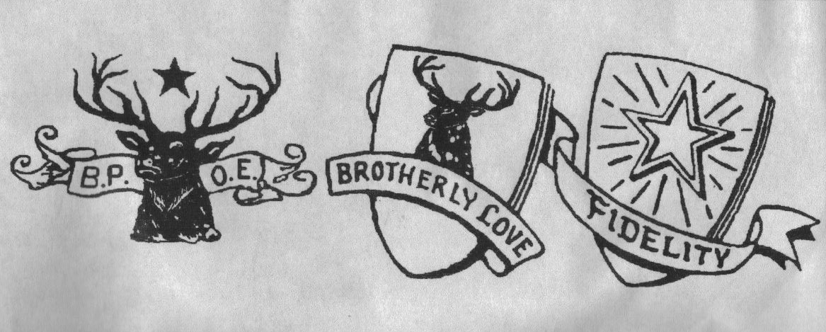

LODGE FRATERNAL FUNCTIONS
RITUALS & CEREMONIES
FUNERALS, FLAG DAY, MEMORIAL SERVICE, VETERAN’S DAY
LODGE MEETINGS
STATE CONVENTION
DISTRICT DEPUTY MEETINGS

Slide 15
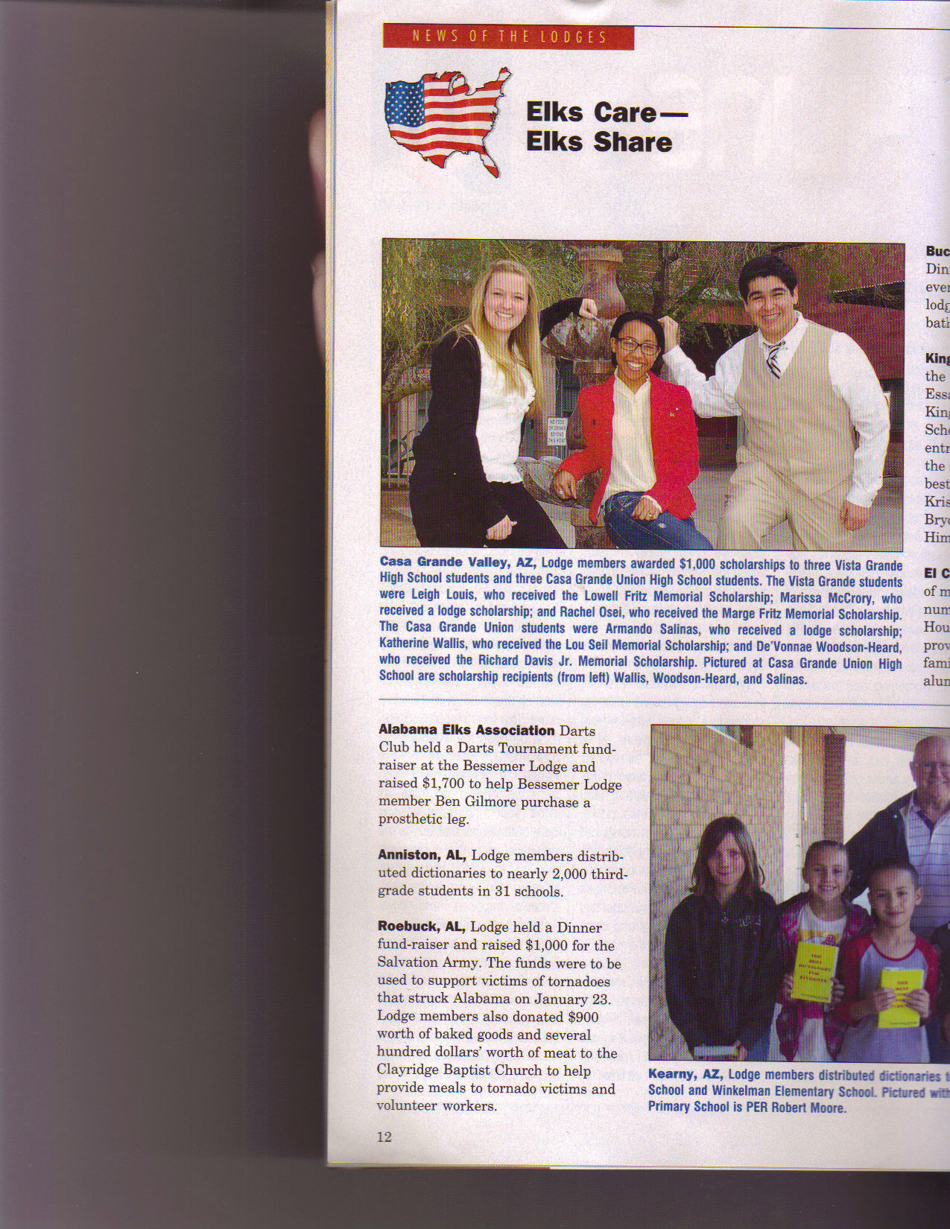
CHARITY
YOUR STATE PROJECT
YOUR LOCAL LODGE COMMUNITY PROJECTS
ELKS NATIONAL FOUNDATION
SCHOLARSHIPS
COMMUNITY & FAMILY RELIEF

Slide 16
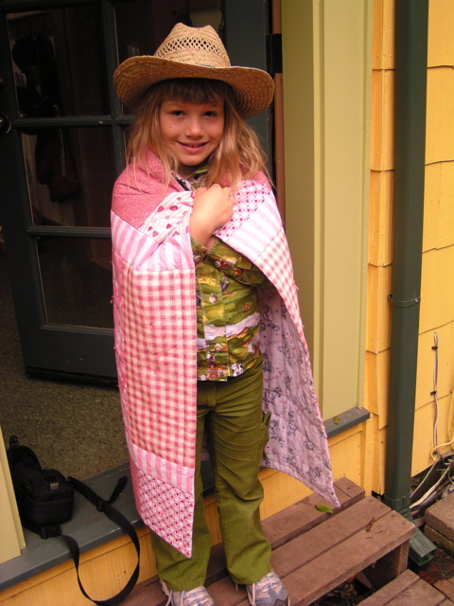
PICTURES OF YOUR STATE PROJECT

Slide 17
MORE PICTURES

Slide 18

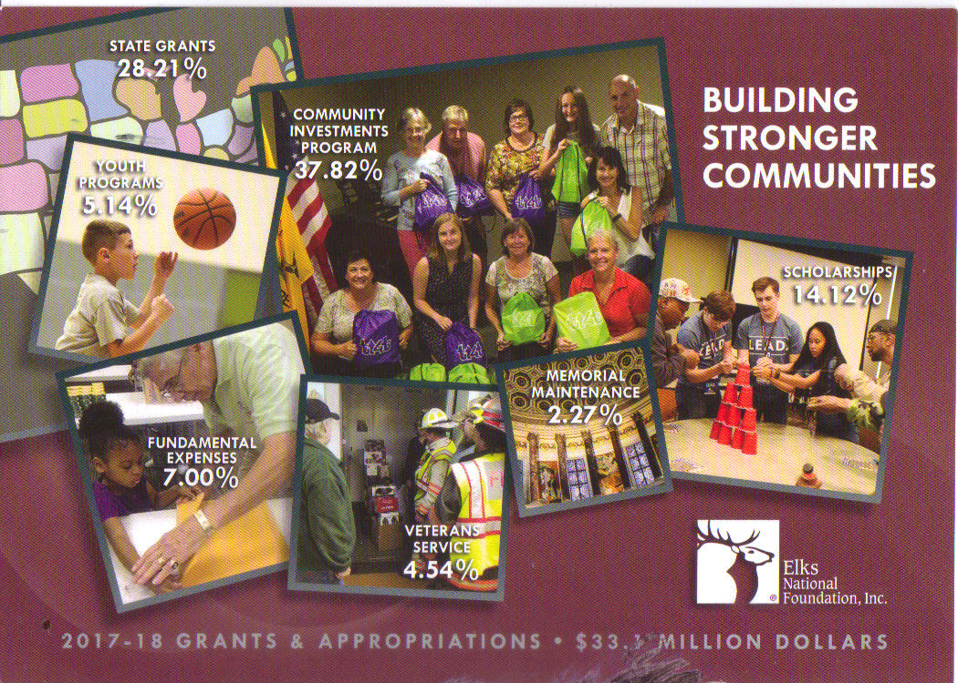
ELKS NATIONAL FOUNDATION

Slide 19
ELKS NATIONAL FOUNDATION
Nationally over $9,000,000 was donated last year, which is over $8 per member
HOW MUCH YOUR STATE DONATED
HOW MUCH YOUR STATE RECEIVED IN grants, scholarships, and support
HOW MUCH YOUR LOCAL LODGE HAS RECEIVED AND SOME PROJECTS THAT WERE ACCOMPLISHED FROM THAT FUNDING

Slide 20
VETERANS
Volunteers provide direct service to Veterans in more than 330 VA Medical Centers, State Veterans Homes , Vets Centers, and other Veterans facilities.
The Elks have pledged $4 million to help end Veteran homelessness
In 2016, Elks contributed in time, travel, goods, and money over $_____ million to more than 323,573 Veterans

Slide 21
Final Charity Report from Grand Lodge
Elks members donated 9,068,210 hours.
Miles driven by Elks totaled 27,958,334.
Total cash and non-cash contributions, and value of time donated = $334,292,982.
How your state ranked #___ with $_______ in donations – over $____ per INSERT YOUR STATE Elk!

Slide 22
LOCAL CHARITY
  SCHOLARSHIPS
  Insert names
  YOUTH ACTIVITIES
Hoop Shoot, Insert other activities
  COMMUNITY PROJECTS
insert your local projects
  RELIEF EFFORTS
  Fundraisers for _____

Slide 23
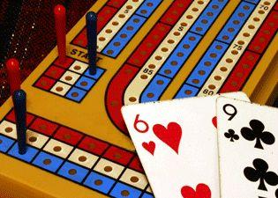

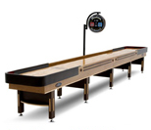
SOCIAL ACTIVITIES
INSERT WHAT YOU HAVE
AND PICTUES
POOL TABLE
SHUFFLEBOARD TABLE
SATURDAY BINGO

Slide 24
SOCIAL FUNCTIONS
INSERT WHAT YOU DO OVER THE YEAR
INSTALLATION OF OFFICERS
HALLOWEEN COSTUME PARTY
THANKSGIVING
CHRISTMAS PARTY
NEW YEAR’S EVE
NEW YEAR’S DAY TOM & JERRY PARTY
SUPER BOWL SUNDAY
CRAB FEED
ST. PATTY’S DAY

Slide 25
SOCIAL
FAMILY FRIENDLY
(Minors are allowed in the lounge area with parental supervision)
Tuesday night Taco feed
Friday night dinner
Saturday Bingo
Mother’s Day Brunch
Halloween Carnival & Spook House
Fishing Trip
Picnic

Slide 26
DISCUSS SOME LODGE COMMITTEES
AND WHAT THEY DO
BE BRIEF
  ACCIDENT PREVENTION – Inspects building and property for hazards, proper lighting and signage, and other safety issues
  AMERICANISM – maintaining flag and historical document displays; promoting flag pins; promoting Americanism Essay Contest
  AUDITING – inspecting income and expenditures in comparison to the budget and reporting to the Lodge during the year

Slide 27
LODGE COMMITTEES
  BULLETIN – encourage submission of articles; edit content; print, collate, label, and deliver to post office
  COMMUNITY ACTIVITIES – organizing and promoting community activities
  DECORATING – decorating the lounge and dining room with seasonal themes
  ELKS CHILDREN’S EYE CLINIC – encourage donations and organize fundraisers; inform Lodge of clinic news; encourage attendance of summer Open House
  GOVERNMENT RELATIONS – reports to the Lodge information passed on by the State Committeeperson concerning legislative issues affecting the Elks

Slide 28
LODGE COMMITTEES
  HIDE PROGRAM – collect and sell deer and elk hides for Veterans’ services
  HOOP SHOOT – organize and run annual free-throw contest in December; attend District contest
  INVESTIGATION – reviews membership applications; interviews candidates; reports recommendations to the Lodge
  MEADOWOOD SPEECH & HEARING CAMP - encourage donations and organize fundraisers; encourage attendance of Memorial Day work party and summer Open House

Slide 29
LODGE COMMITTEES
  MEMBERSHIP/LAPSATION – promote recruitment of new members; retain current members; promote reinstatement of lapsed members
  ORIENTATION – instruct new members about the Elks, their functions, charities, and programs
  PUBLIC RELATIONS – promote dissemination of Lodge activities and programs in the Lodge’s Bulletin, local media, and The Elks Magazine.
  RITUAL – organize rituals (installation, Flag Day, Veterans Day, Memorial Service, Funeral/Graveside, Initiation

Slide 30
LODGE COMMITTEES
  SCHOLARSHIP – distribute Most Valuable Student information and encourage participation, judge brochures and interview applicants, and participate in District judging; distribute Lodge’s scholarship information and encourage participation, and judge brochures.
  VETERANS – promote Veterans’ programs; collect and deliver items (toiletries, books, quilts, etc.); assist Veterans in need; Adopt-a-Vet; PTSD counseling; drivers for vans to Burns clinic and Boise VA Hospital
  VISITING – visit hospitalized and shut-in members
  YOUTH ACTIVITIES – promote and organize youth activities: proms, grad nights, dances, Halloween parties, Christmas party, promote Student of the Month program

Slide 31
HOW TO VOLUNTEER
BAR – bartend one night a week, or as a fill-in, or for special events
KITCHEN – cook a meal, or help with set-up, serving, and clean-up
MAINTENANCE – help with projects (work parties, courtyard clean-up, carpet cleaning, etc.)
COMMITTEES – reactivate a committee with guidance, join an active committee

Slide 32
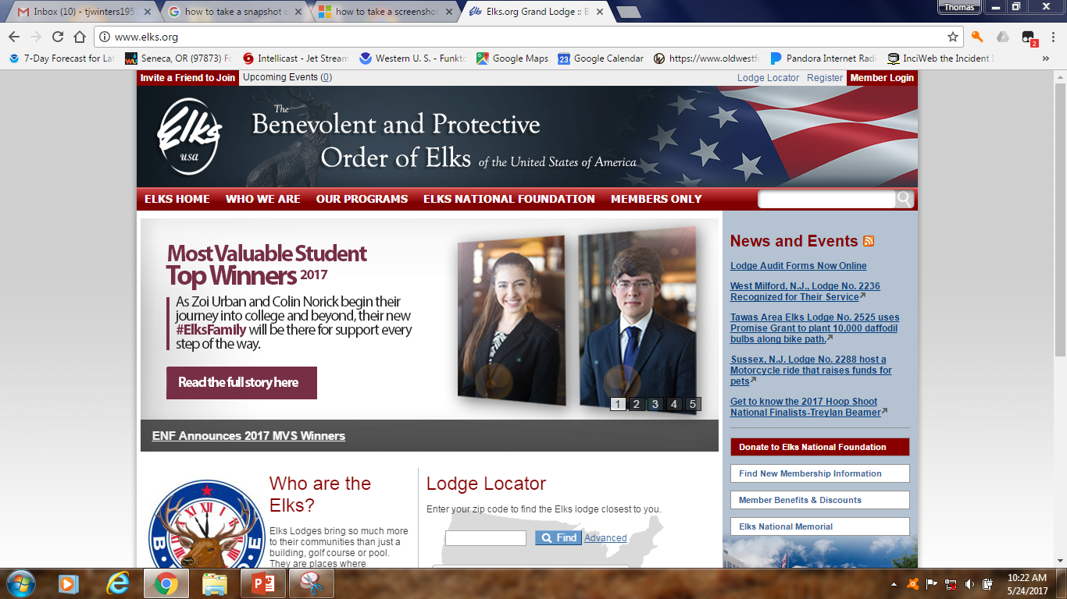
www.elks.org

Slide 33
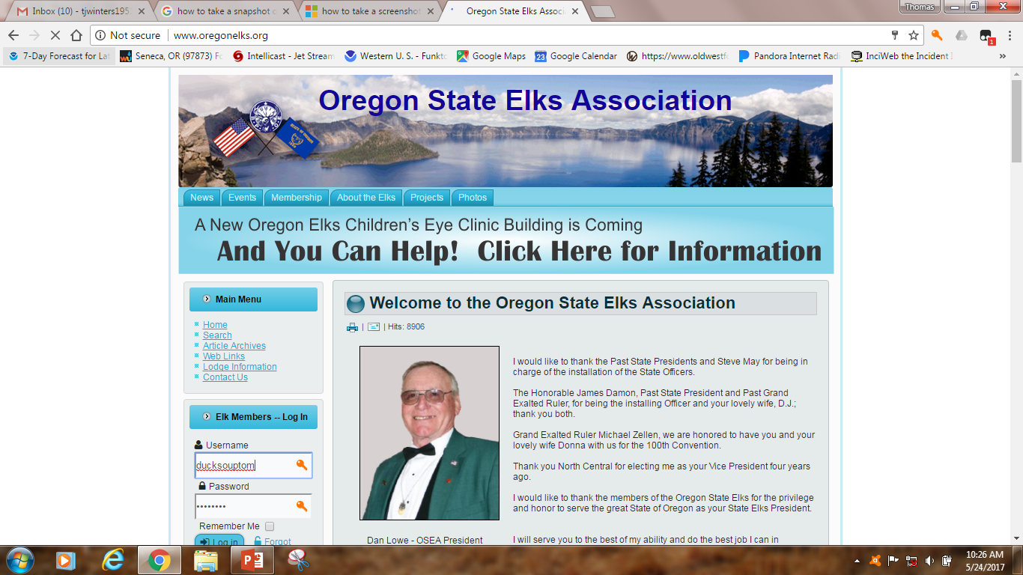
www.oregonelks.org

Slide 34
LOUNGE HOURS
TUESDAY – SATURDAY
4:00 PM – 8:00 PM or later, Saturday: 1-6 PM
Closed on Sundays, Mondays, and Holidays
LODGE MEETINGS
2ND and 4TH THURSDAY at 7:00 PM
Except July & August (4th Thursday only) , November (2nd and 3rd Thursday) , & December (2nd Thursday only)
No alcoholic beverages allowed during Lodge meetings
The bar is closed during Lodge meetings
No marijuana allowed on the premises (buildings, parking lot, etc.)

Slide 35
Discussion topics
Harassment
  Sexual
  Verbal
Discrimination
Overconsumption of beverages
Smoking policy if applicable
Cannabis policy if applicable

Slide 36
Discuss Initiation
Reduce fears and anxiety
Generally discuss the process
Discuss old English pronounciations
HAVE THE NEW MEMBER LISTEN AND REFLECT ON WHAT IS BEING SAID

Slide 37
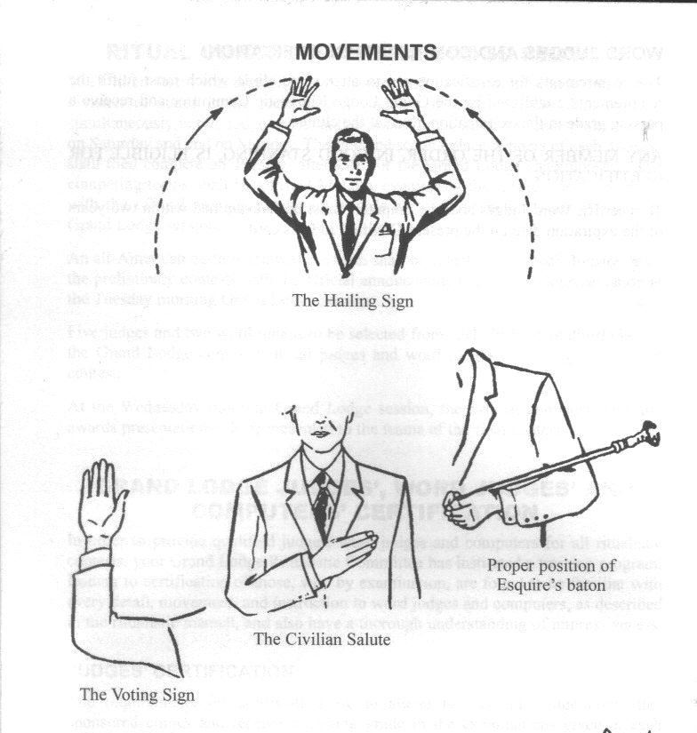

Slide 38
REMEMBER
AN ELK IS ALWAYS AN AMERICAN CITIZEN
WHAT YOU SEE AND HEAR WITHIN THE LODGE SHOULD STAY WITHIN THE LODGE
LOUD AND VULGAR LANGUAGE IS NOT TOLERATED AT ANY TIME – BE AWARE OF YOUR SURROUNDINGS
HATS ARE NOT ALLOWED IN LODGE MEETINGS OR IN THE DINING ROOM DURING LODGE SPONSORED DINNERS
(unless part of a costume during special functions)

Slide 39
Welcome
To our
Elks Family

